Slide 1



From Paper to Digital Tools: An Overview of the Transition at Empa
4. September 2025 presentation created by Stefanie Hauser and Anusch Bachofner
Notes:
Welcome everyone and thanks for joining this show an tell session with me.
For today, I prepared a presentation where I want to talk about the digitalisation in our organisation and our findings in that topic.

Slide 2
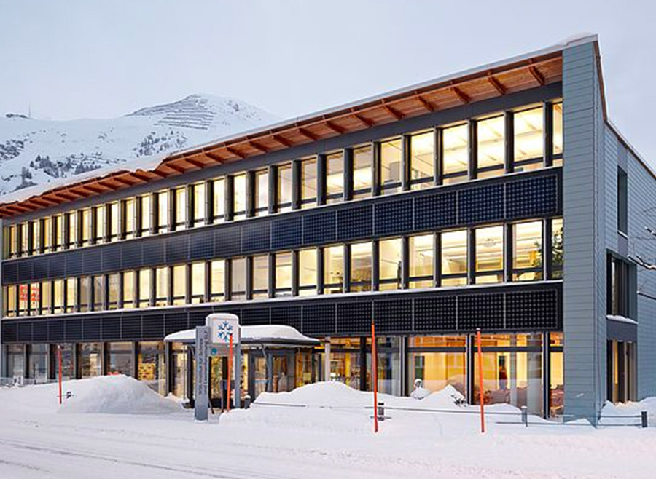
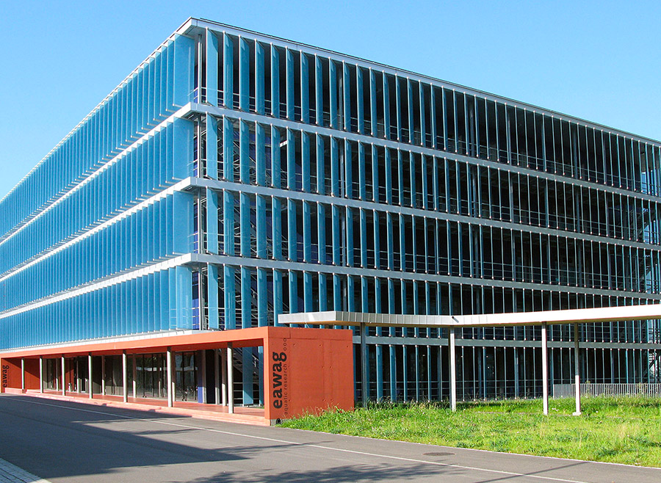

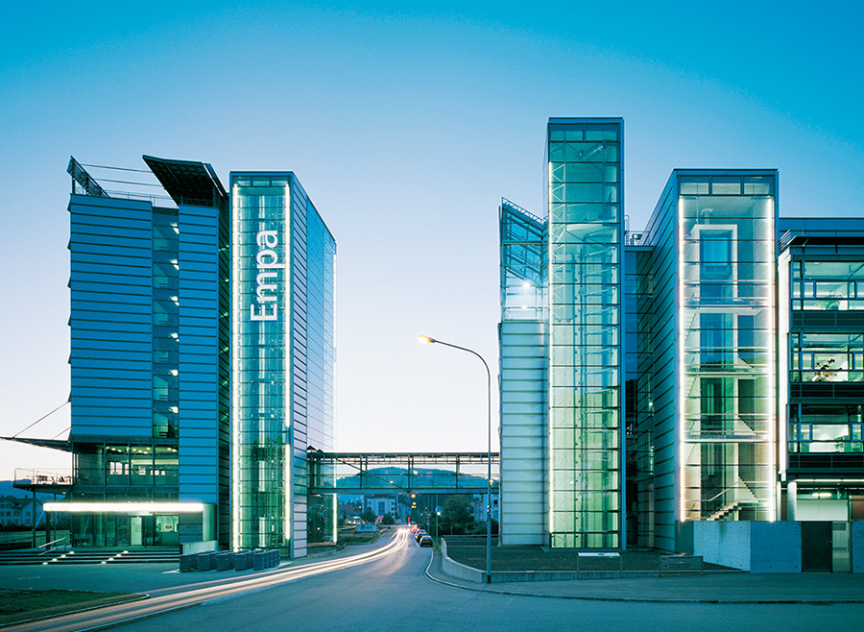


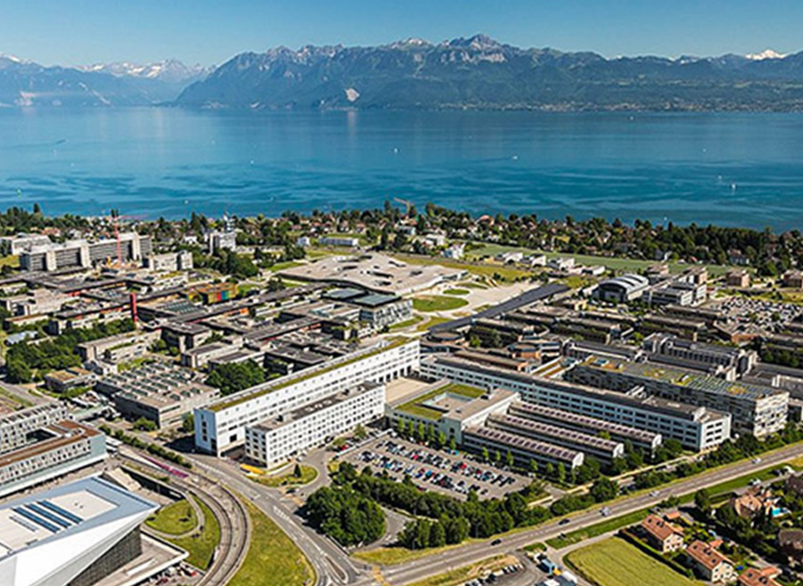


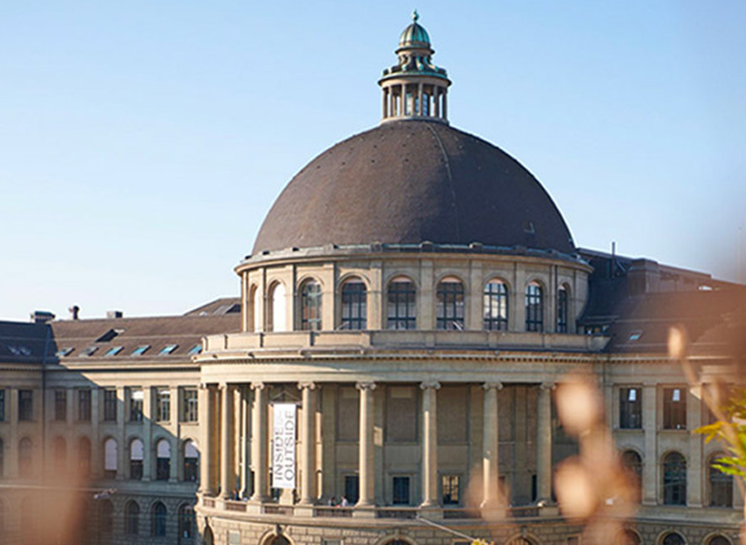
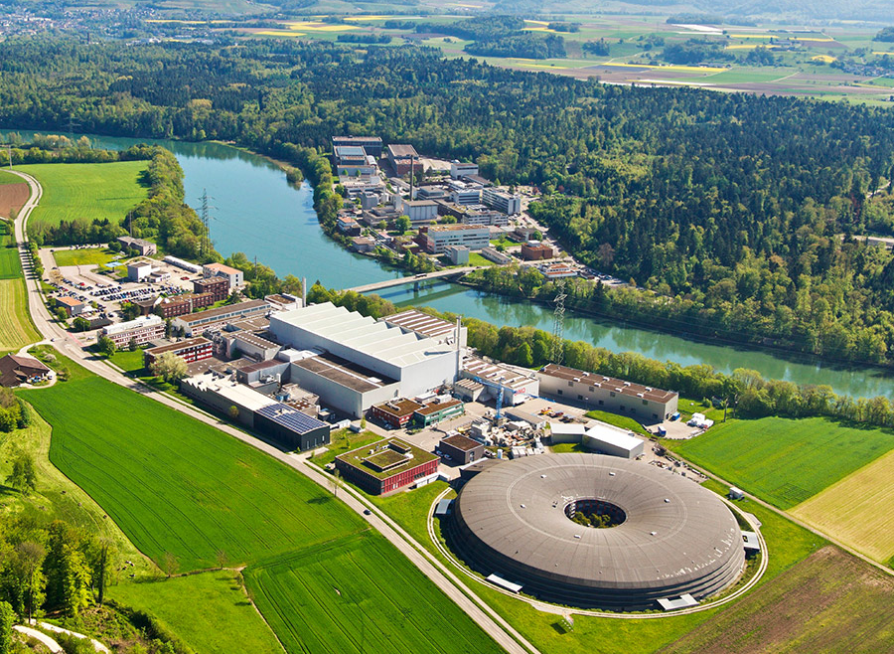

Four research areas
Around 1100 employees
Including more than 660 researchers
Nanoscale Materials and Manufacturing Technologies
Built Environment
Health
Energy, Resources and Emissions
Part of the ETH Domain
Empa
Materials and Technologies for a Sustainable Future
WSL - Empa - Eawag - PSI - ETHZ - EPFL
Notes:
But before I start into the topic I want to introduce a bit our organisation.

Slide 3
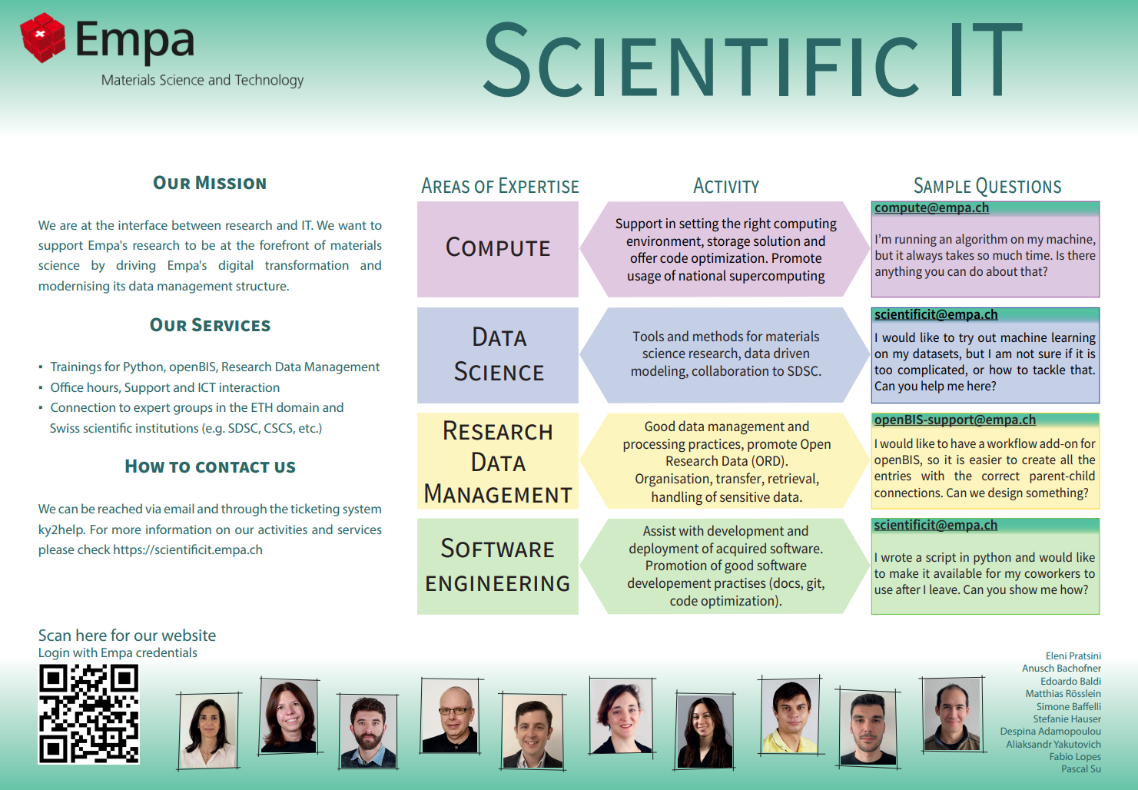
Notes:
And I work in the group of scientific IT.
We are a relatively new group at empa tackle the challeng to bridge the gap between science and IT.
I work in Research Data Management and I now also take part in two ORD projects that involve Data Stewardship.
Data stewards are people, that help researchers with their data management.

Slide 4

In research data management, digitalization helps with…
Documenting
Searching for information
Connection between metadata and data
Backups and archiving of data
Sharing & Collaboration
Sustainable & Reproducible
Funding agencies
FAIR data management
Required data publication
Long term preservation
Access management
Saving time
Reducing effort amount
More citations
Better recognition
Notes:
Currently, research data management always comes along with the topic of digitalization.
I think, what digitalization means is mostly clear, but still I want to shortly show the main topics from our perspective

Slide 5
Hurdles to digitalisation
Research Data Handling
Technical Barriers
Perceived simplicity of data: Small datasets, tabular form, low in storage needs, appear manageable without structured approaches.
Lab-specific Barriers
Writing on Paper is faster than starting a device
Lab environments can be dirty or hazardous → electronic devices risk damage.
Organizational / Cultural Barriers
Lack of suitable electronic lab notebooks (ELNs) or RDM tools for specific data types.
Poor integration with lab instruments, analysis software, or institutional systems.
Steep learning curves / non-intuitive interfaces.
Resistance to change and perception of RDM as extra work: Established paper-based or ad-hoc practices are deeply ingrained, and digital RDM is often seen as bureaucratic rather than supportive.
Human factor
Risk of file format obsolescence or software no longer being supported → Often caused by short-term decisions (choosing convenient but proprietary formats).
Intellectual property concerns and fear of losing control before publication → Leads to withholding/sharing data in insecure or ad-hoc ways.
Uncertainty about long-term funding for digital infrastructure → Researchers may avoid adopting new tools, fearing they will vanish (a trust/decision issue as much as a systemic one). Paper has proven to be long living, despite all the
Lack of training in digital tools and RDM best practices → Leads to errors, inefficiencies, and misuse of digital infrastructure.
Lack of clear responsibilities and incentives: No one is explicitly accountable for data quality, and academic rewards focus on publications, not data stewardship.
Disciplinary differences and time pressures: Research fields follow different norms, and heavy short-term output demands leave little time to develop consistent, long-term data practice.
Uncertainty in early project phases: At the start of research, data may remain unsorted, and future structures or requirements for collaboration are often unclear.
Notes:
If we talk about the pros of digitalization, we also need to talk about the cons.
I tried to identify the reasons, why people don’t start digitalize right away, although it seems such a good reason to.
Over the years of working in research, talking to researchers, surveys in our organisation I came up with the list above, which maybe is not complete yet.
I see the following points as the main reasons why people don’t work digital.

Slide 6

to support research data management
Description of
Experiments
Measurements
Processes
Data analysis
Electronic Lab Notebook
Data Management
Inventory of
Samples
Materials
Reagents
SOPs
Equipment
Inventory Management
Storage of research data connected to the experiments described in the electronic lab notebook
A data management system – Connecting lab inventory and lab notebook in 1 tool
Notes:
To support the digitalisation we need tools.
One of those is openBIS and we started introducing it several years ago. In the following slides I will talk a bit about how the introduction of this software in our organisation is happening and also as an showcase for digitalisation topics.
In case you don’t know what openBIS does: it’s a software developed in ETH Scientific IT Services and here are some key points to it.

Slide 7

Timeline & status of openBIS introduction at Empa
August 2019
Evaluation of pilot
Preparation of proposal to Directorate
May 2020
Start of 2021
openBIS pilot with 5 labs
openBIS introduction in 26 labs in collaboration with Empa IT, Scientific IT and ETH SIS
Onboarding workshops held & rollout of trainings and support
Set up of a ticketing tool in Jira for receiving support requests and also development wishes
Directorate funds 2 year roll out project
End of 2022
Separate development contract over 2 years with ETH for usability requests from researchers
Further documentation & training developments, a lot of user support
Development of specific User Interfaces through projects
Status of openBIS usage: Around 50 active users
~5 labs have a user group of 5-10 people
~8 labs are still in starting phase with openBIS with 1-3 people
2025
Notes:
The first introduction of openBIS at Empa happend already 6 years ago.
- First there was a piloting phase
- Roll out for 2 years, where by the end every group got access and an introductory to the software
Further 2 years we had a separate development contract with ETH SIS, where we could improve the usability for our users
(example: QR codes and Barcodes usability improvement or improval export/ import function)
We continued introducing smaller collaborations with labs for integration of openBIs in experimental workflows
But by now, still not a lot of people started using it and everything took more time that what we expected in the beginning. But slowly more users and use cases arise.

Slide 8
Challenges of introducing openBIS at Empa
Choosing the right software
Empa has a different kind of research areas distributed over 30 labs from material sciences, physics, chemistry to biology
Labs in different research areas and setups have different needs for features and usability
IT project management and infrastructure
On-Premises-Software vs. Software-as-a-Service:
Not enough resources to host at Empa
Software-as-a-Service can be very expensive. Inexpensive solutions are not necessary ready-to-use for different use cases
Low experience in project management for software introduction:
Project steps and organization need enough resources and focus
software has less priority and acknowledgment in research
Change Management
Adaption of processes: from paper to digital workflows
Low acceptance if not enough resources and priorization is dedicated to the change
Error culture needs to be on a high level (one needs to be able to learn from errors)
Trainings
Not enough ressources for enough intensive and specific trainings depending on preconditions

Slide 9


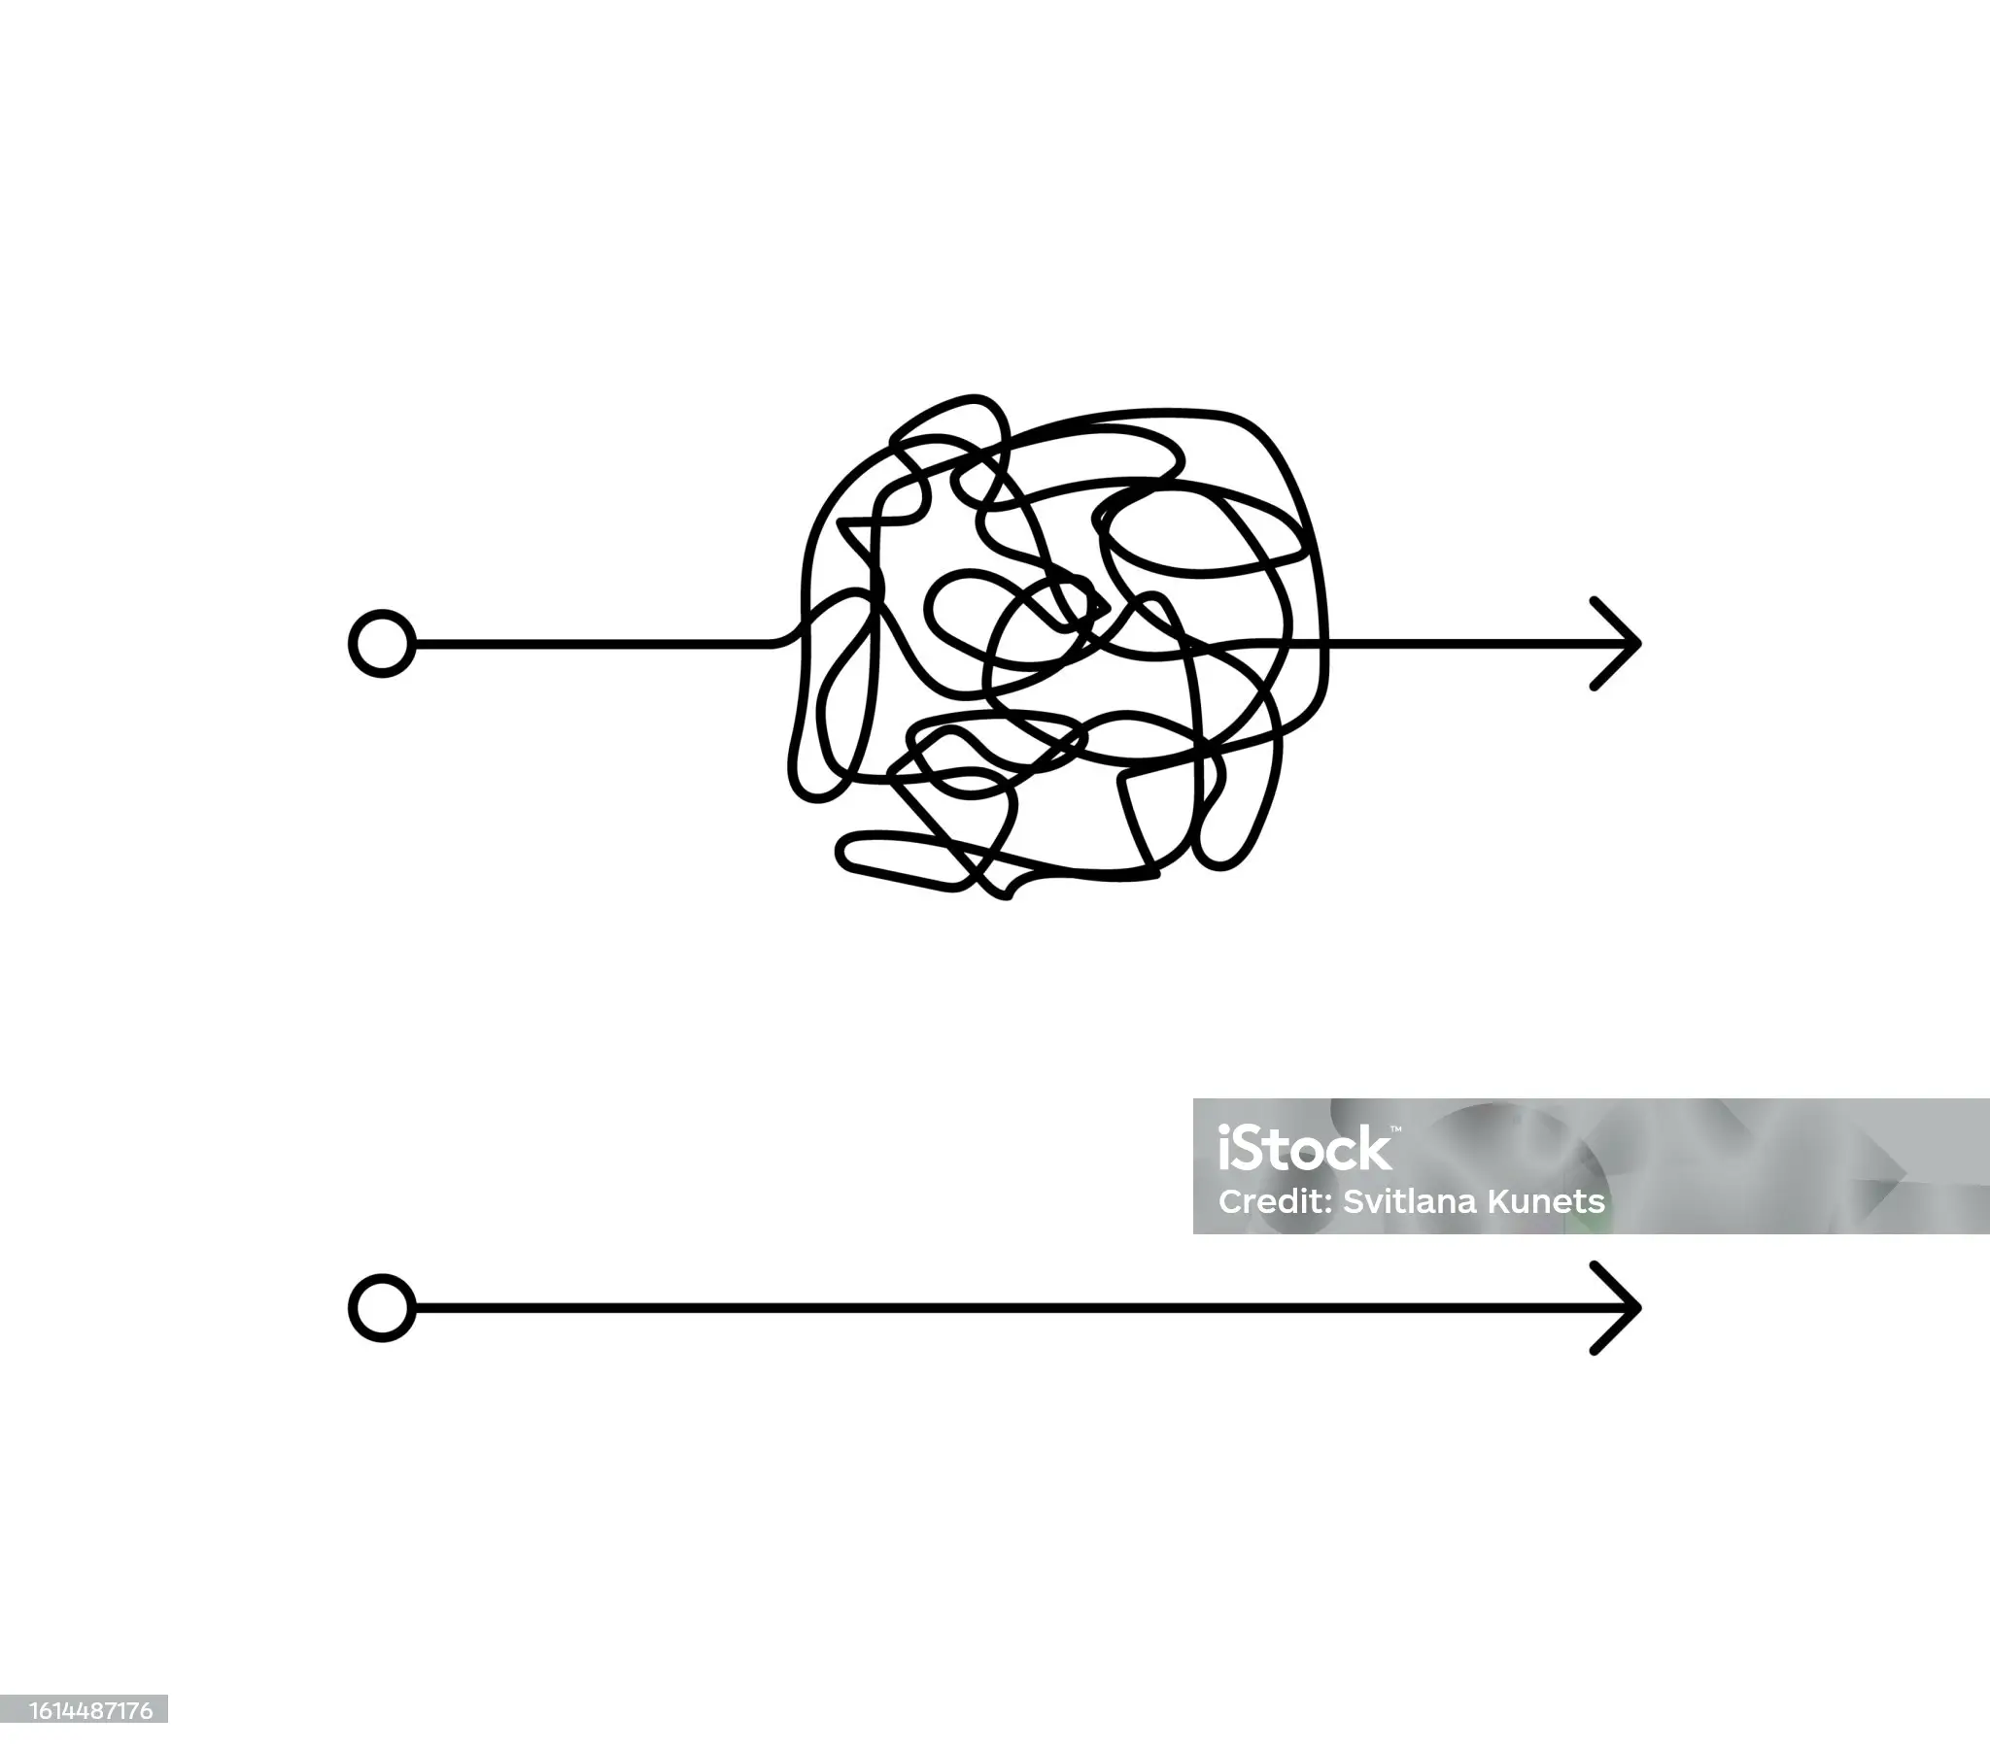
Our steps to tackle the challenges to introduce openBIS
Targeted workshops
For onboarding: show people how it can be used
For requirements engineering: find out what people want
Specific documentation & trainings
Support easy self learning to reach more people
Highlight information about trainings and contact for support
Document common use cases and share with all users
Choose the right entry points for the users to manage expectations
Low: Manage the inventory with Chemicals, Devices, QR-/Barcodes, Documents
Middle: Data modeling for selected projects
High: Connect analytical devices to openBIS for automatic data ingestion

Slide 10
Why is adoption of openBIS still so slow?
What would help to speed up the process
Resolve usability issues of openBIS
What we will do in the mean time
Document more use cases for the different labs & research areas
More dedicated resources for helping at the point where it is needed
Look at a wider range of possible tools, it may not need a one-size-fits-all solution.
Rewarding set up of digitalization processes and support from a strategic management level
What are the reasons we see
Empa has a high percentage of staff turnover every year.
Empa's diverse research landscape is not particularly conducive to a bottom-up approach.
We have to accept that change always takes time, maybe we are still in the middle somewhere
Continue work on user documentation, training and support

Slide 11
Further Steps to support digitalisation in Labs
Accessible help and training opportunities
Regular office hours
Webpage for easy sharing and as a central point of information
Bridging Knowledge Gaps
Developing tools and guidance for evolving needs
iLog: digital inventory logbook integrated with openBIS. Presented by Simone Baffelli just before
PREMISE: an ORD Project for adoption of ORD standards (https://ord-premise.org/about/)
Promotion of digital inventories and how they can be set up
Central spaces for communication and sharing
Introductory Python courses
ticketing system
Showcasing collaborative tools and project
Teams channels for communities like Data&Software or openBIS
A new storage-needs assessment tool and a central web interface help researchers navigate the research data life cycle.

Slide 12
Now I’m curious
Have you encountered any barriers yourself with regard to digitalisation?
Do you work in experimental laboratories? If so, how do you digitise your data?
What is your experience of working with electronic lab notebooks?
Do you use a tablet or similar device to take notes?
Have you worked on projects that involved the automation of analogue processes?
What are the steps taken at your organization to help the digitlaisation?

